Slide 1
Consumer Responsibilities

Slide 2
Consumer awareness
Consumers are more conscious of where and how they’re products are produced.
Producers are now responding to this change in consumer preferences.

Slide 3

Have you seen this symbol before?
Do you know what it means?

Slide 4


One area where firms are responding to changing patterns of demand is the fair trade movement.

Slide 5
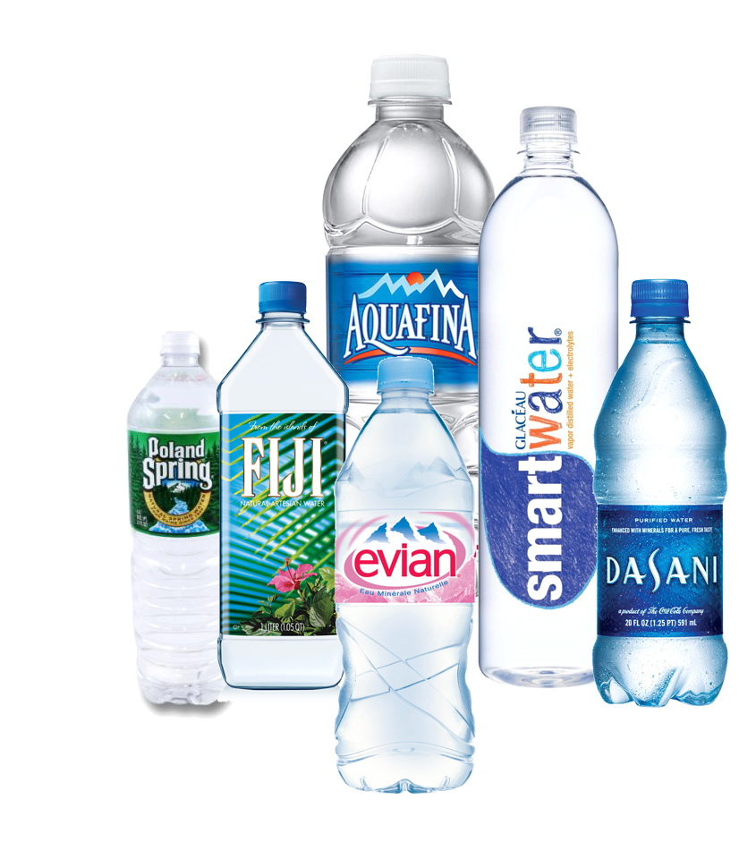
Boom in bottled water.
Pure, natural and healthy. The "clever and powerful" marketing of bottled water has led to Australians buying record amounts at prices far higher than for milk or petrol.

Slide 6
But there is a change in consumer demand emerging now…
Reusable bottled water and coffee cups

Slide 7
Why? Because consumers are becoming more environmentally conscious. If we demand goods that are more environmentally friendly, consumers will respond by making or adapting their products to achieve this.

Slide 8
Refer to your handout on ‘Responding to consumer demand’

Slide 9
Read the sections called “Fair Trade Chocolate” and “Reusable water bottles and coffee cups”
Then answer the questions below:
State when the fair trade movement began.
Complete the sentence “When a firm advertises…”
Outline how the fair trade movement has effected consumer preferences and the sale of chocolate in Australia.
State how much money Australian’s spend on bottled water each year.
Complete the sentence “The rise in popularity of…”
Complete the sentence “According to Clean up Australia, it takes up to..”

